Slide 1

POTHOLE EFFICIENCY
Strategic Plan for the Newly Appointed Pothole Czar in Kansas City
Presented by Patrick M Curran
Notes:
I knew for this dashboard project, I wanted to do something outside the realm of baseball. Although I had put a lot of work into my Kansas City Royals’ metric tree, I wanted to find something with more current and available data that I felt I could do something with. It was during this time that I read an article in the Kansas City Star about Mayor Quinton Lucas’ desire to appoint a pothole “czar”.

Slide 2
Pothole Czar
On February 10, Mayor Quinton Lucas announced his desire for hiring a pothole “czar”.
Acting City Manager Earnest Rouse would be responsible for finding a candidate for the job internally.
The pothole czar would help set priorities, coordinate efforts among departments and improve response times.
Notes:
On February 10th of this year, the mayor announced he would be asking acting City Manager Earnest Rouse to appoint a pothole “czar”. This individual would be appointed from within government.
Since there is already a director of the Public Works Department, many people felt the appointment of this position was unnecessary and that the money should be spent hiring more workers to fill the potholes.
Regardless, Mayor Lucas said the job of the pothole “czar” would be to set priorities, coordinate efforts among departments, and improve response times. Using these three directives, I created a metric tree that would be the jumping off point for the new pothole “czar”.

Slide 3
POTHOLE CZAR METRIC TREE
 | Strategic Objective | SMART Goal | Metric Name | Metric Narrative | Metric Formula | Metric Level | Metric Type | Frequency | UoM | Target
FINANCIAL | Improve the efficiency of the Public Work Department | By the end of Quarter 2 in 2021, improve the cost per pothole filled by 60%. | Cost per Pothole | One of city governments most important jobs is the making sure it is spending taxpayer dollars efficiently and wisely. So whether the city decides to hire more public works employees or analytics, a good measure of the city's stewardship of the budget is to determine the cost required to fill each pothole. | Dollar Spent on Filling Potholes / Number of Potholes Filled | Level 1 | Lagging | Daily | Percentage | 60%
CUSTOMER | Increase citizen satisfaction with the Public Works Department | By the end of 2021, improve the customer satisfaction of pothole resolution by 50%. | Customer Satisfaction | A way to measure the success of the pothole czar is to determine if citizen feel the performance of the Public Works Department in improving. On the yearly, Kansas City citizen survey, a question should be asked directly about the city's performance around pothole resolution. | Customer Satisfaction Score in 2020 / Customer Satisfaction Score is 2021 | Level 1 | Lagging | Yearly | Percentage | 50%
 |  | By the end of Quarter 1 in 2021, decrease the number of 311 cases by 50% from 2020 levels. | 311 Call Center Reports | Another way of measuring pothole resolution success is by the number of reported cases coming into 311. If potholes are being filled more efficiently, there should be less calls. By comparing the measure to the previous year, the city can see, not only if they are improving their pothole efficiency, but all if the preventative maintenance being done the rest of the year is making a difference. | Total Cases Reported in 2020 / Total Cases Reported in 2021 | Level 1 | Real-time | Daily | Percentage | 50%
INTERNAL PROCESSES | Increase the efficiency of pothole resolution | By the end of Quarter 1 in 2021, improve the number of pothole cases resolved on-time by 60%. | Pothole Efficiency | One of the first things that must be done to improve overall performance within the Public Works Department and to improve citizen satisfaction is to improve the efficiency with which potholes are filled. If the city is going to give an estimated timeframe for a pothole to be filled, it must improve this metric first a foremost. | Cases Not Resolved on Time / Cases Resolved on Time | Level 1 | Lagging | Daily | Percentage | 60%
 |  | By the end of Quarter 1in 2021, the average days to resolve a pothole case in each district should be within one day of each other. | District Efficiency | Not only is pothole efficiency important, but pothole efficiency within each district is important as well. Citizen need to feel as though resources are being deployed equitably throughout the city. This will also give the pothole czar a look into which districts may be lacking and need help improving. | Calculate the Average Number of Days Between Creation Date and Close Date by District | Level 1 | Lagging | Daily | Decimal | 1
LEARNING & GROWTH | Develop a nationally recognized analytics department | By the end of 2020, develop a route efficiency algorithm to deploy at the beginning of 2021 to increase on-time pothole resolution when using the algorithm to 90%. | Route Efficiency | Since every case is geocoded, one way to help with the efficient resolution of potholes is to create an algorithm that can be used to help crews determine the most efficient routes for resolving as many potholes as possible. | Cases Resolved Not Using Route Efficiency / Cases Resolved Using Route Efficiency | Level 1 | Lagging | Weekly | Percentage | 90%
 |  | By the end of 2021, develop a protocol for identifying infrastructure for preventative maintenance, so that beginning in Quarter 2 of 2022, 70% of preventative maintenance projects can be complete in a calendar year. | Preventative Maintenance | Perhaps the best way to improve overall pothole performance is to improve the completion of preventative maintenance projects during Quarter 2 and Quarter 3. The goal would be to improve road conditions, so potholes do not form in the first place. | Number of Preventative Maintenance Projects Completed / Number of Preventative Maintenance Projects Identified | Level 1 | Lagging | Weekly | Percentage | 70%
Notes:
One important metric, especially with peoples’ concern about the need to create a new paid position in the first place, is the cost incurred by the Public Works Department to fill potholes. If the creation of this role could lower the cost to fill potholes, the position could pay for itself. This metric is not going to appear on the dashboard, because I do not have the financial data necessary to create it, however I think it would be a good metric for the new pothole “czar” to have. Not only to justify his own position, but also to show Kansas Citians that the government is a good steward of their taxpayer dollars.
The next two metrics related to customers are important, because the true role of city government is to provide services to its citizens. The customer satisfaction metric is not something that would need to appear on the dashboard, since it is a yearly survey. However, monitoring if customer satisfaction is improving is something to keep an eye on. A metric around 311 Call Center data would be an important metric to have on the dashboard. The metric described on this metric tree would be comparing the number of reported potholes compared to the same time the previous year. This would give the pothole “czar” an understanding on whether they are improving on a year to year basis. So even if customer satisfaction may not be improving, tangible results of progress can be shown. This particular metric does not appear on the dashboard, since I did not filter for last years 311 pothole reports. There is another 311 Call Center metric I feel would be appropriate to the dashboard, and I will be discussing this on the next slide.
The dashboard for this project will focus mostly on internal processes. Since the main reason the mayor is appointing a pothole “czar” is to improve internal processes around resolving potholes, I felt this was the area I wanted to focus my dashboard. So the dashboard will be focusing on the metrics the pothole “czar” will be able to look at daily to gage progress. I will be discussing these metrics when I go over the dashboard.
Finally, I will discuss the learning and growth metrics at the end of this presentation to discuss steps moving forward after this year’s pothole season has come to an end.

Slide 4
Data Collection
311 Call Center Service Requests dataset from Open Data KC
The dataset was filtered for all pothole reports for the first eight weeks of 2020
January 1 – February 25
Of the 4,493 pothole reports, 1,959 were duplicates
2,534 unique requests
Recommend the use of live data
Notes:
The data I used for these metrics and this dashboard was 311 Call Center data from the Open Data KC website. One important point to make here is that reports are not just collected by those who call in. Reports can also be created through the website, email, or through the 311 chatbot. I filtered the records to include only those reports from the first eight weeks of 2020. In other words, from 12:01AM on January 1 to 11:59PM on February 25.
If this dashboard was to be created and used by the pothole “czar”, I would recommend using live data from the 311 Call Center dataset, since this dataset is continually updated whenever a new report is created.
One last note on the cleaning of the data before use. In the timeframe indicated there were 4,493 reports made to the 311 Call Center about potholes in the first eight weeks of 2020. However, 1,959 were duplicated reports that other people had reported, sometimes weeks apart. After removing these duplicate records, 2,534 unique records remained. The fact that nearly 44% of the reports were duplicates is alarming. That is why I would include a metric on the dashboard that tracks these duplicate records. Duplicate records illustrate that the pothole has been sitting as an open record for quite some time, or if the reports are close together, the pothole may be a significant problem for drivers and should be repaired immediately.
Since I wanted a clean dataset with unique records, and I wasn’t quite sure how to produce this metric in Tableau, so the metric is not included on the dashboard.

Slide 5
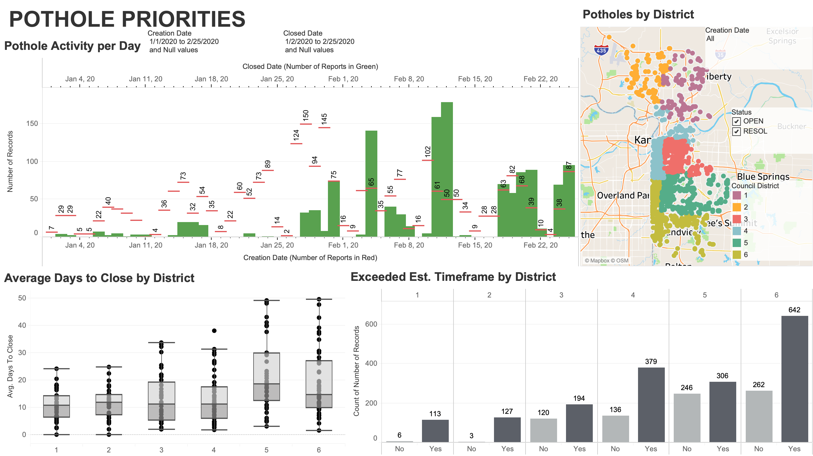
Notes:
This is the pothole “czar’s” Pothole Priorities dashboard.
I will be discussing each of these graphics on subsequent slides. However, I wanted to mention the three metrics I previously discussed that I would put on this dashboard. With how large many of these graphics currently are, I do believe the seven-total metrics on this dashboard could be displayed without too much crowding and would provide invaluable information to the pothole “czar”. If necessary, however, some of these metric graphics could be drill down graphics that do not have to appear on the dashboard “home screen”, especially as it relates to the ”by district” information.
The first metric I would add is the cost per pothole metric. This would simply be a number that is created by the daily cost incurred by the crews in the Public Works Department divided by the number of potholes reports resolved on that day.
The other two metrics are specifically about 311 Call Center reports. The first metric would look at how the city is doing in comparison to the number of calls from the same time the previous year. This too could easily just be a number or percentage to let the pothole “czar” know if the city is making improvements and could also be used for anticipatory purposes based on previous patterns. The second 311 metric would be to track the duplicate reports about the same pothole. As mentioned previously, the reason for the duplicate report is most likely for one of two reasons: either the pothole has not been resolved in a timely manner so the same call keep coming in about the same pothole or the pothole is so severe that a number of different citizens keep calling in on the same pothole.

Slide 6
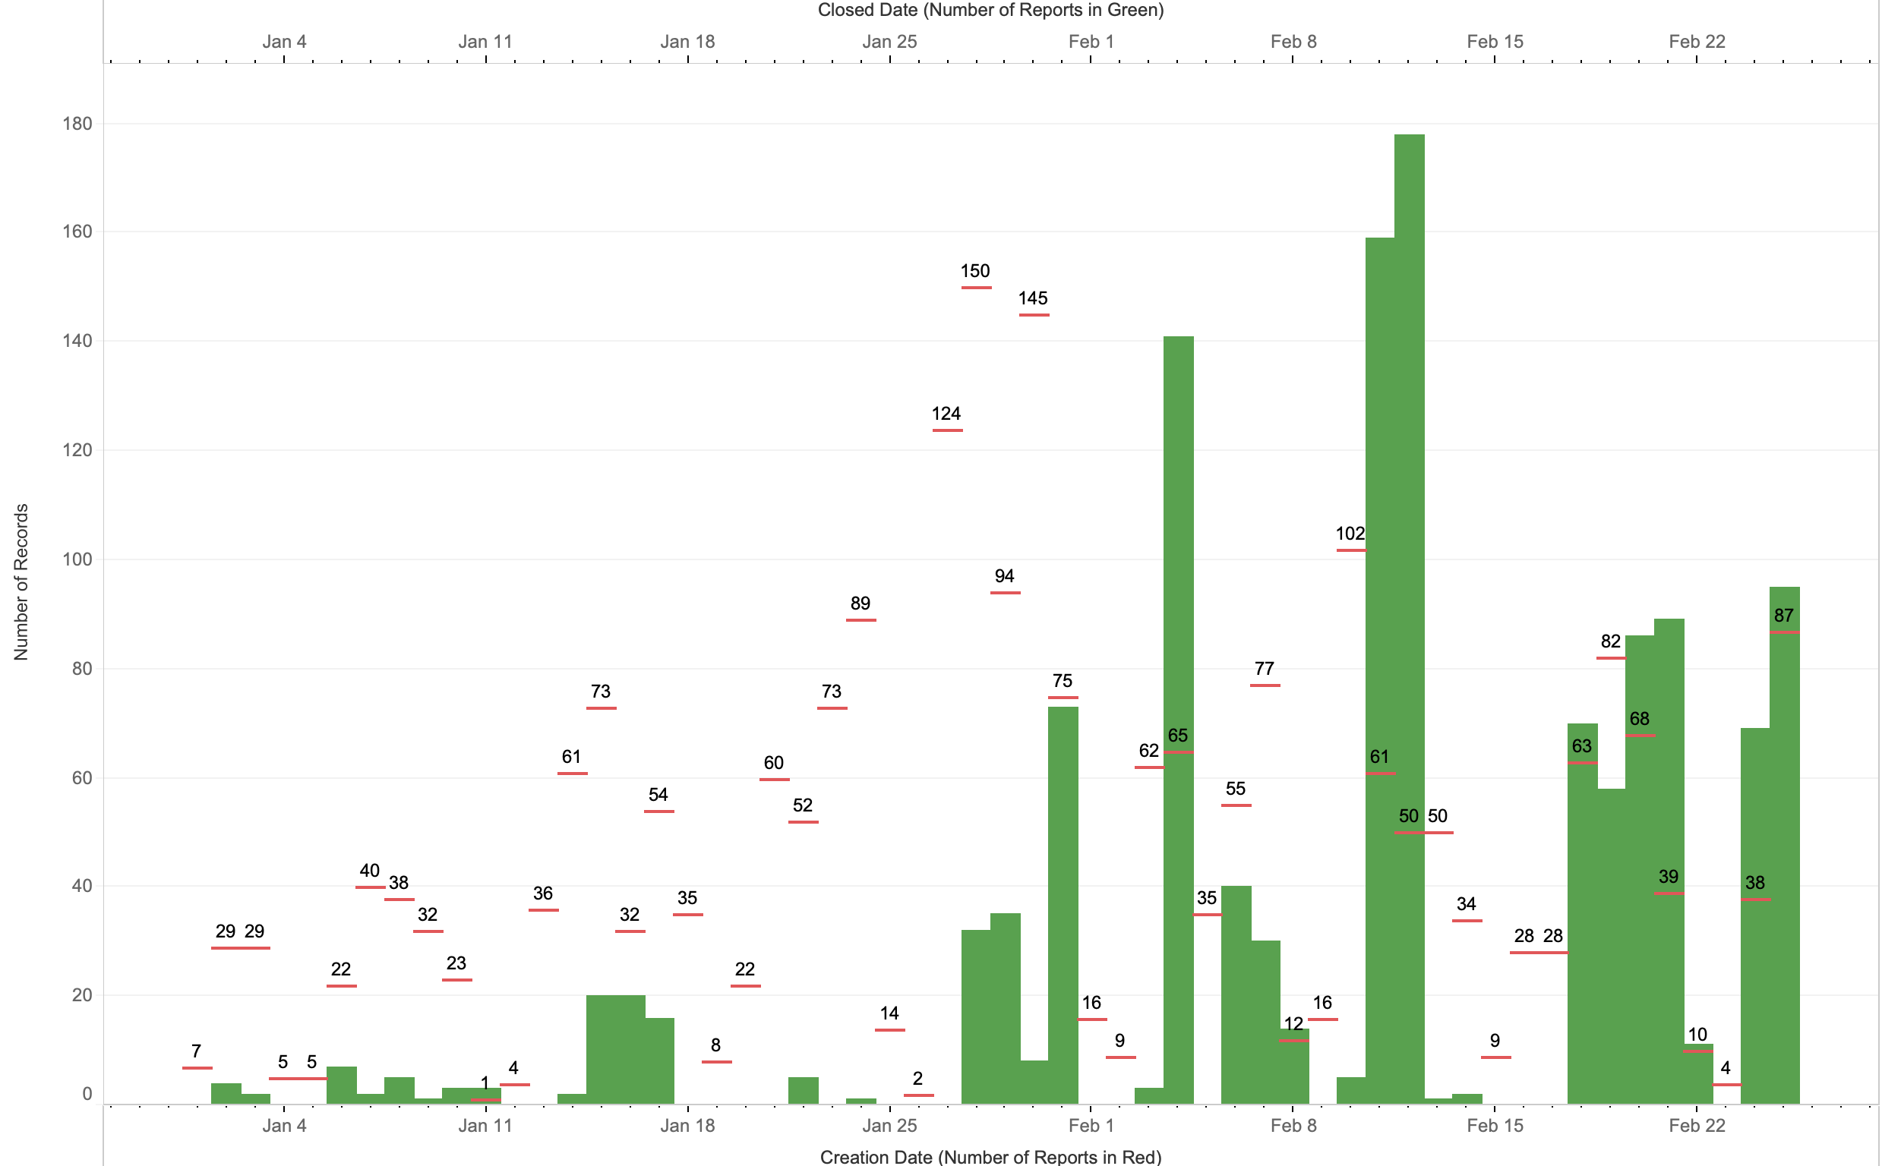
Pothole Activity per Day
Notes:
The “Pothole Activity per Day” graphic shows the number of reports opened and closed on any given day. The red Gantt bars are the number of reports created each day and the green bar chart is the number of reports closed each day. So the goal is for the green bar to be higher than the red bar to show progress being made. This chart can be filtered by creation date and closed date, to get a more refined view of what is going on during a given time period. Especially if this data is live, there is no need to have every day of the year displayed. At first glance, it is interesting to note that pothole progress appeared to have increased after the mayor came out with his pothole “czar” announcement.

Slide 7
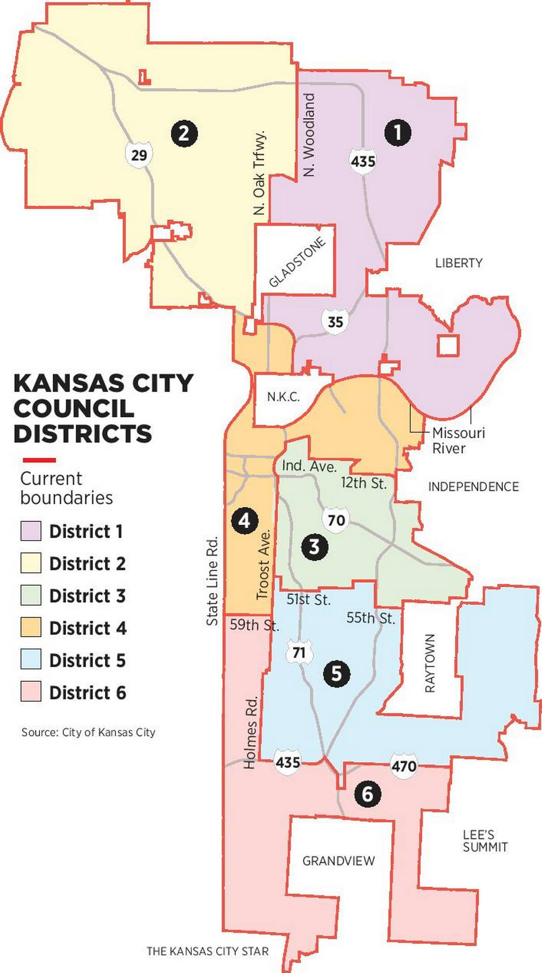
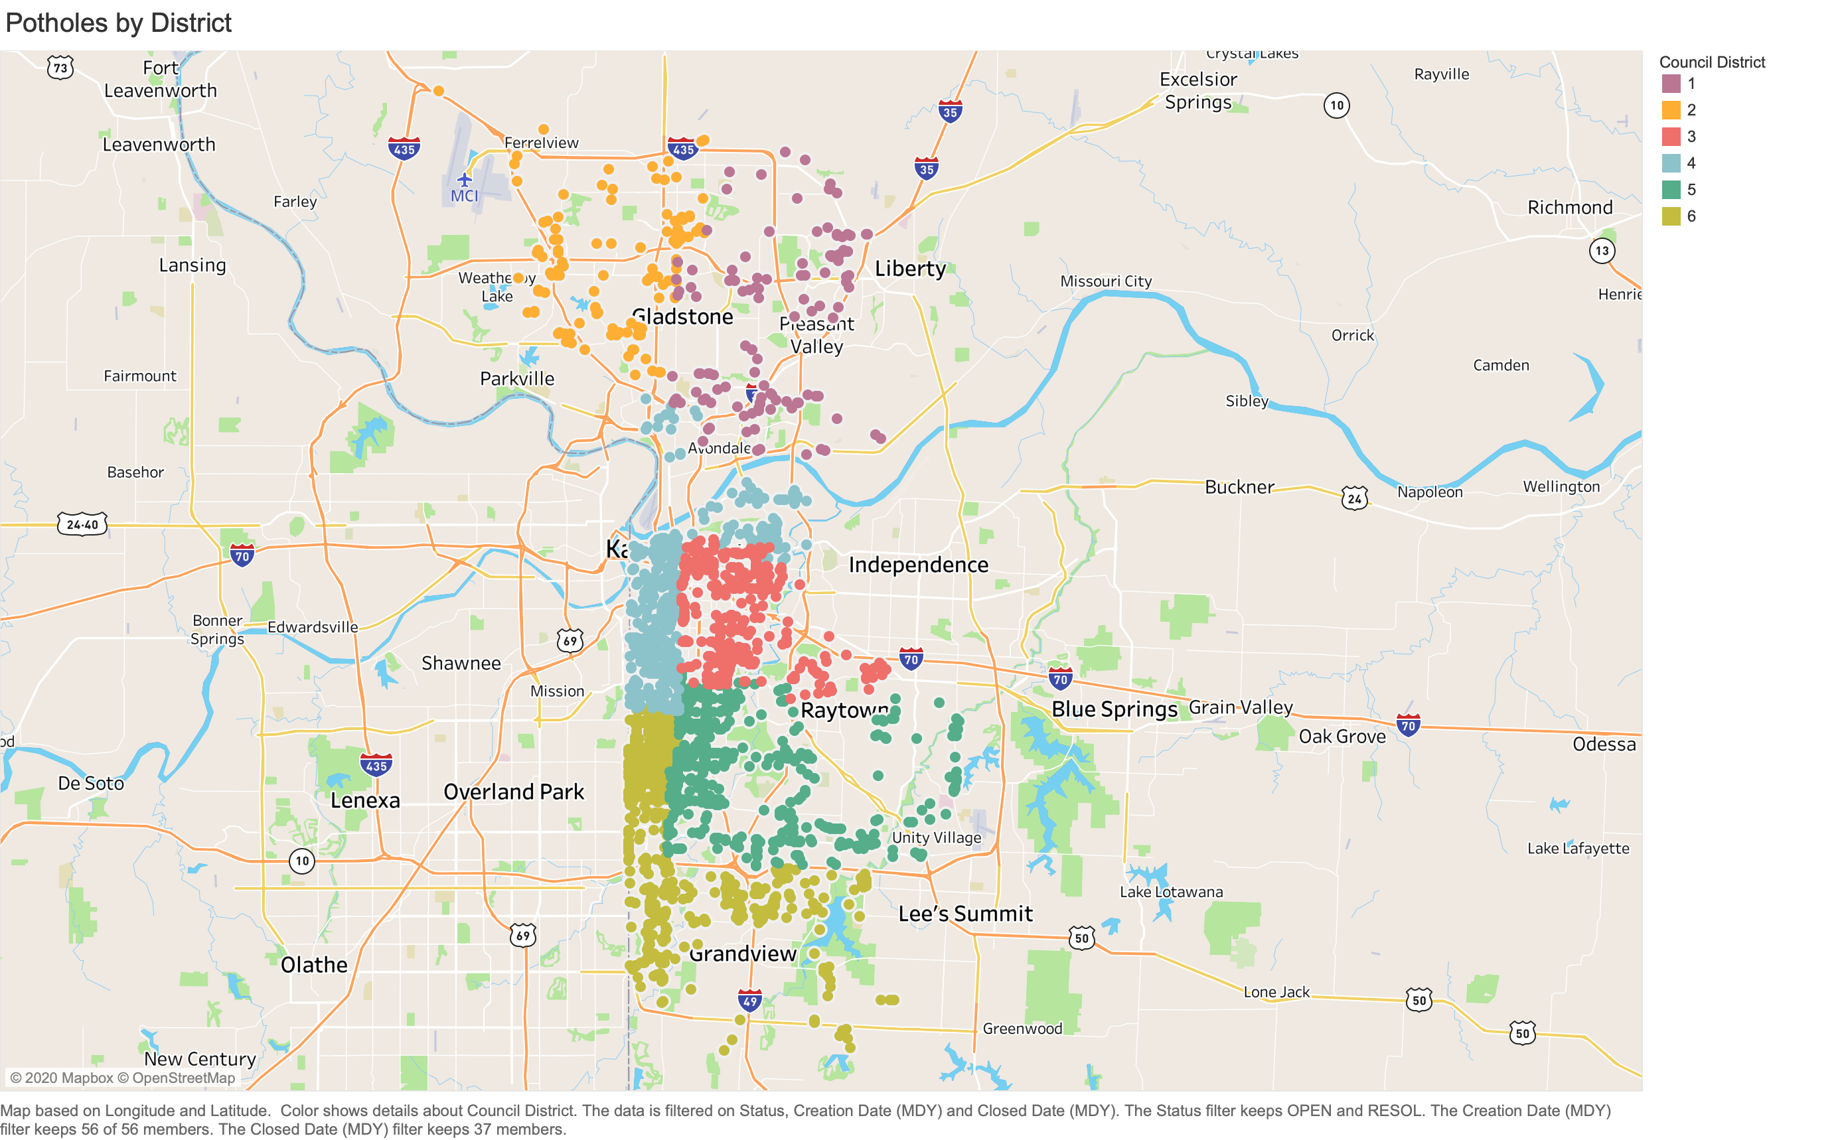
Potholes by District
Notes:
The “Potholes by District” map, shows the geographic distribution of potholes by city council district. The map on the left is purely for reference on how the districts are laid out geographically. This map can be filtered in three different ways. The first is by creation date. Using the creation date filter in conjunction with filtering for status and by district can be quite powerful. For instance if the pothole “czar” were to filter for reports that were still “OPEN” along with a range of creation dates, he or she could see which reports have been open the longest and in what district. The geocoded data used to create this map will also be helpful in the development of a route efficiency algorithm, which will be discussed at the end of this presentation.

Slide 8
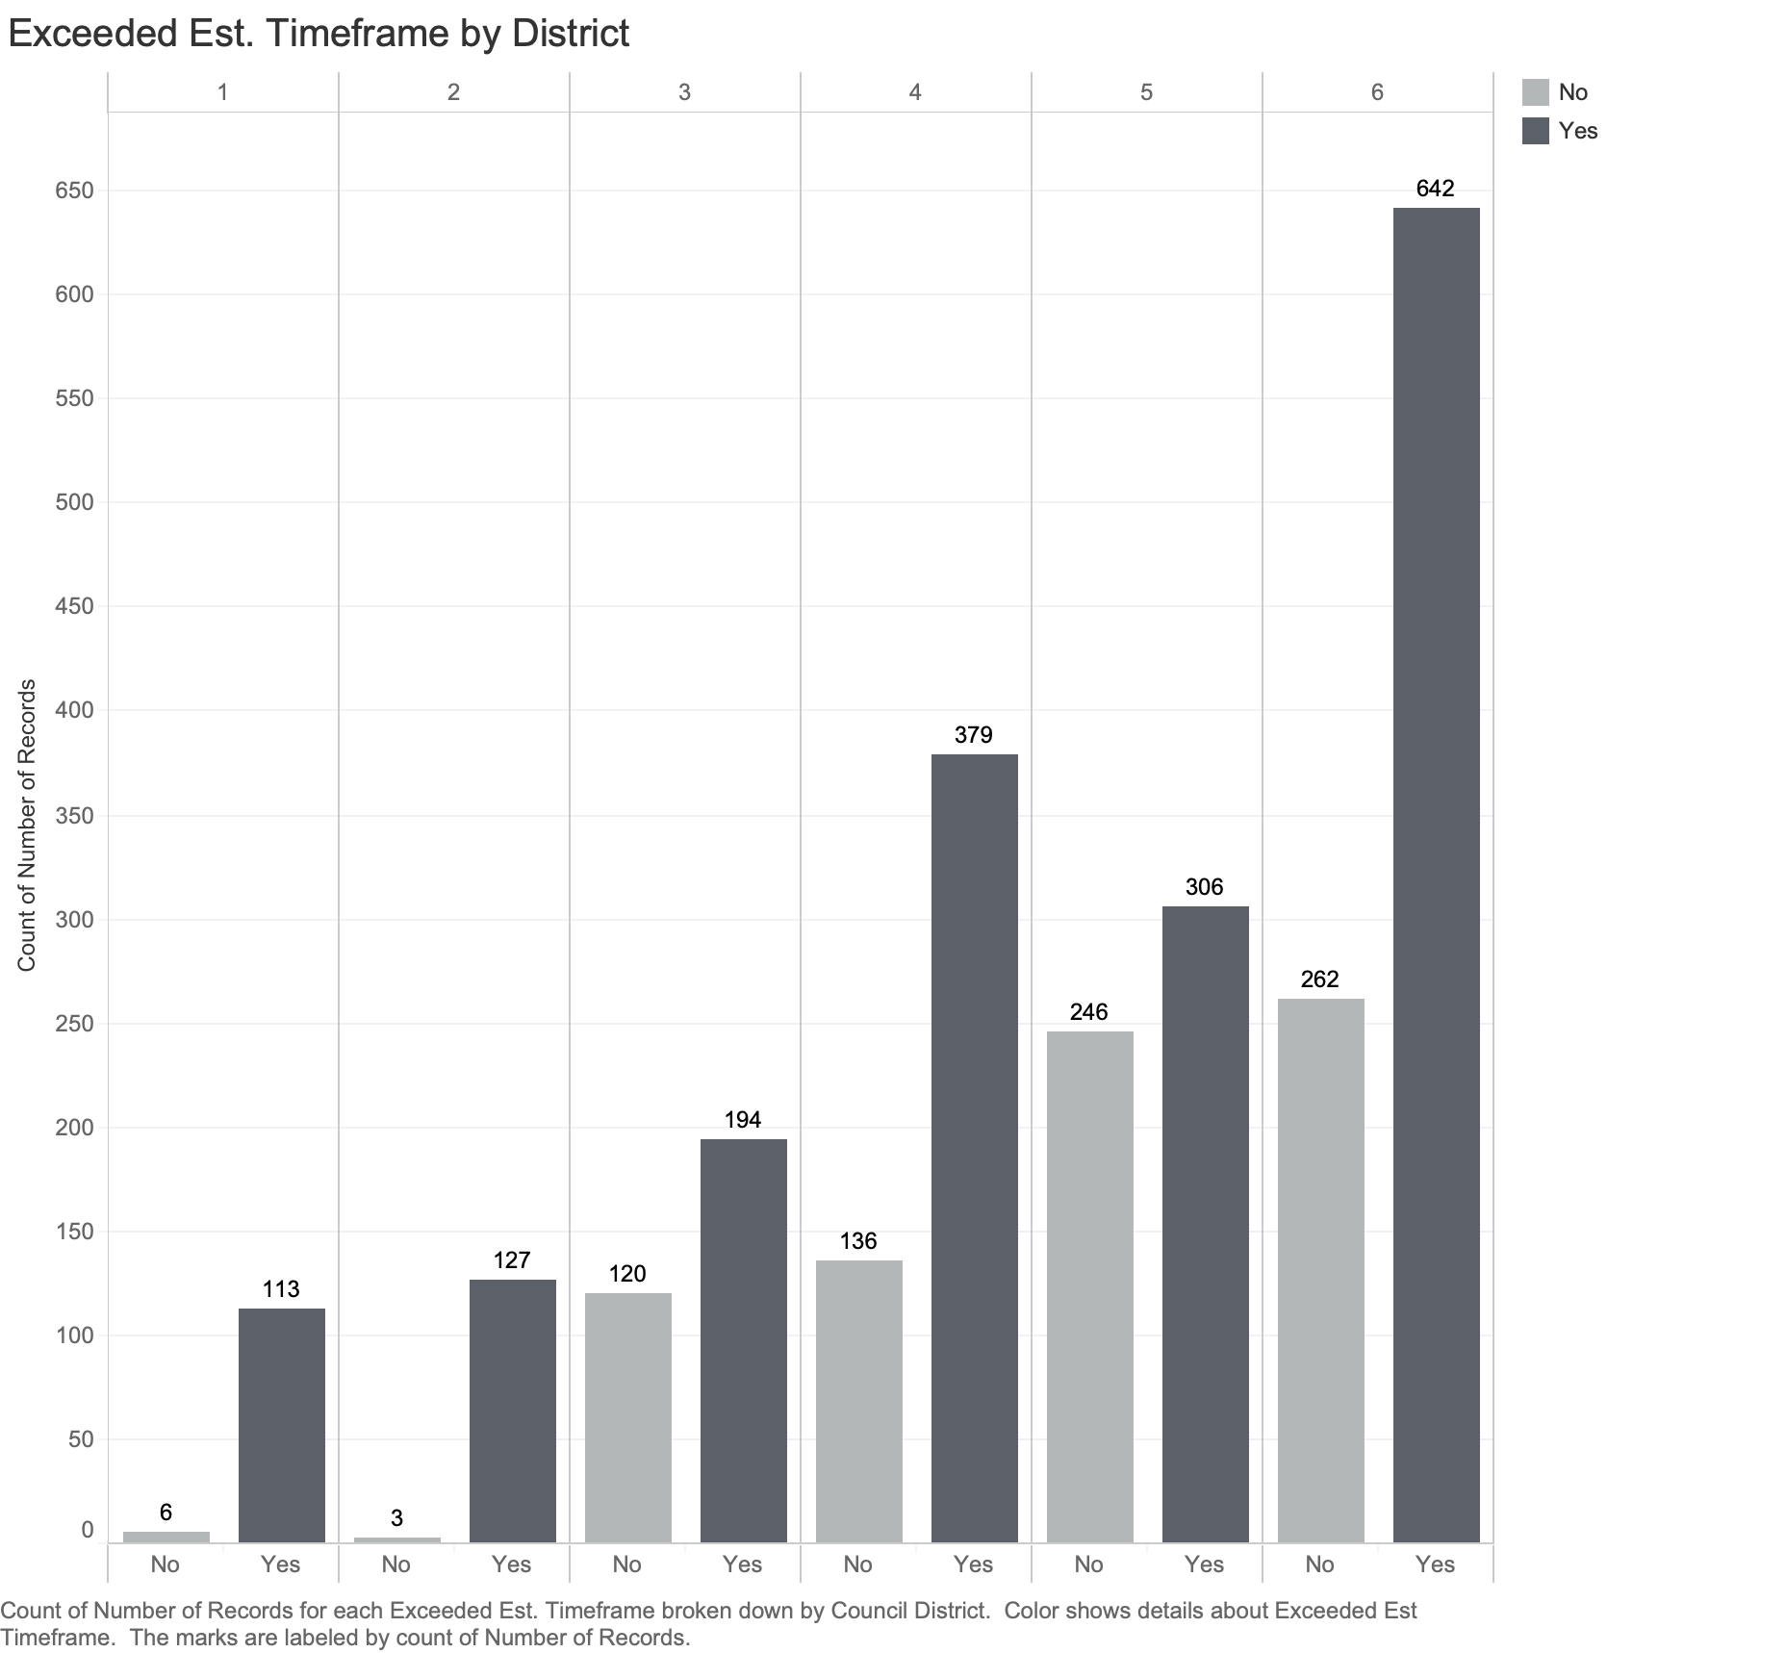
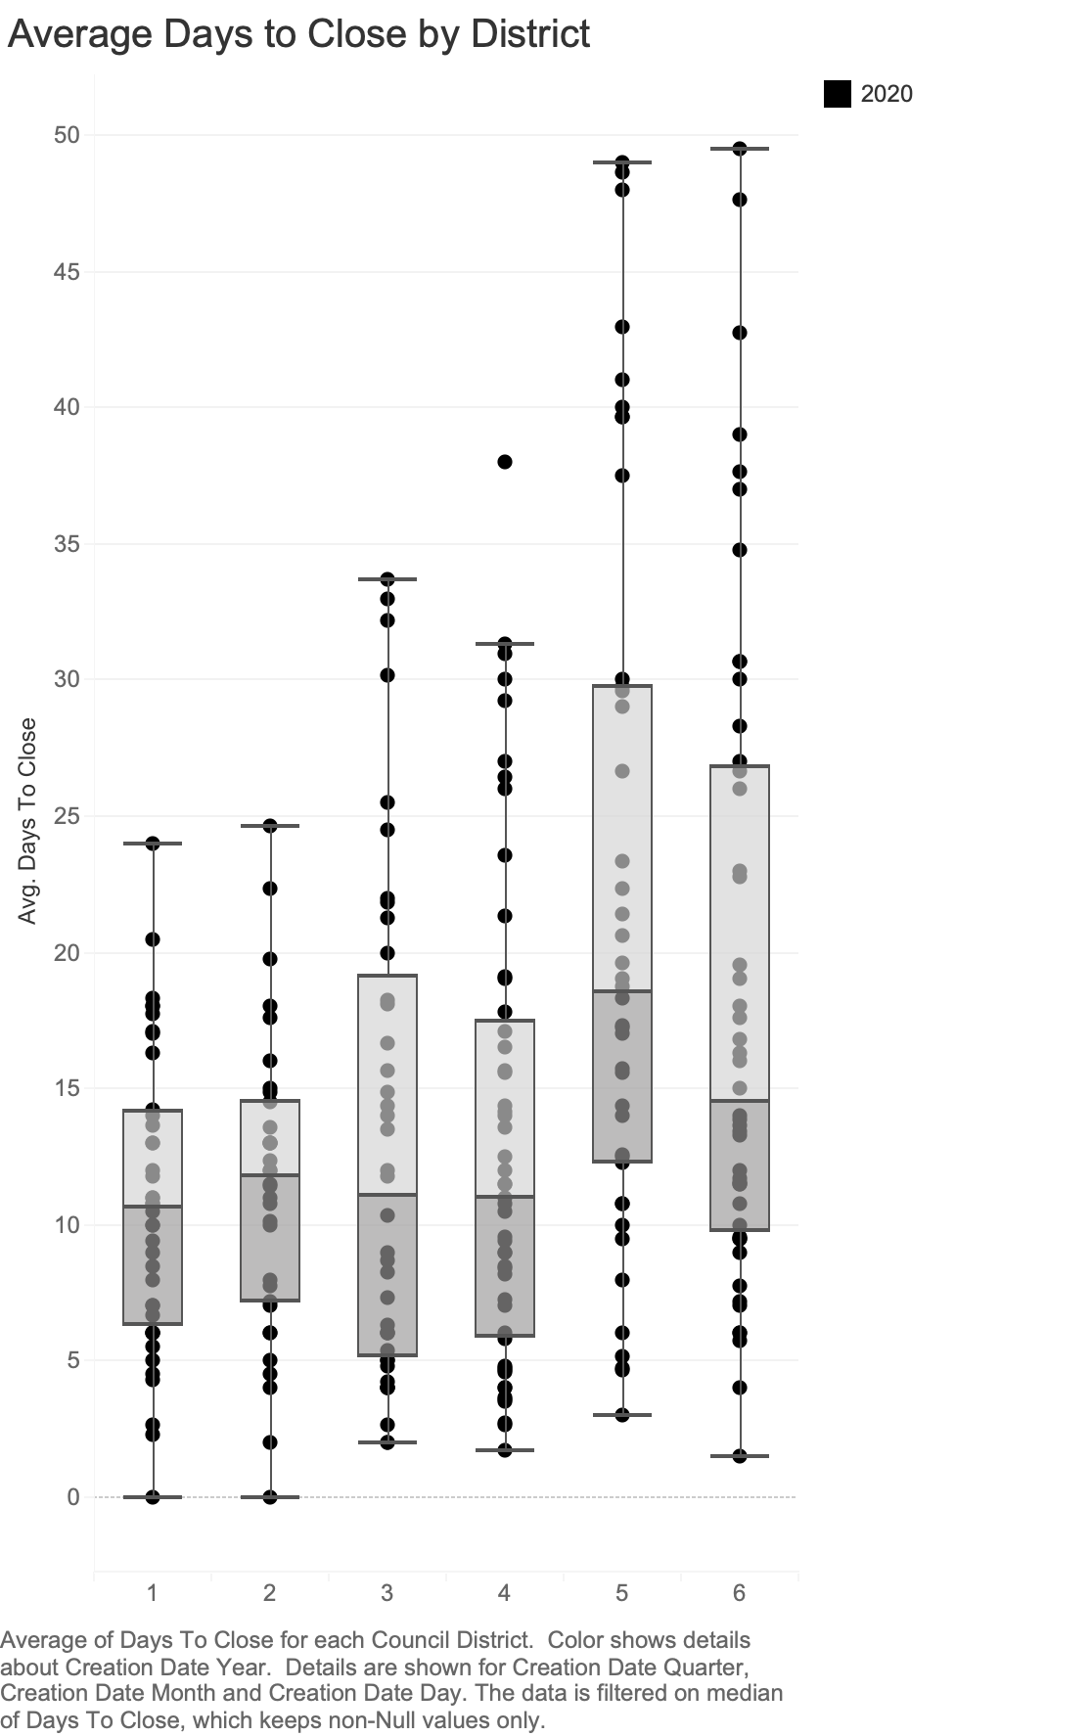
Resolution by District
Notes:
The two graphs at the bottom of the dashboard “Average Days to Close by District” and “Exceeded Est. Timeframe by District” bring the dataset down to the district level. The map gives a good overview, but these two graphics allow the pothole “czar” to drill down further into how each district is performing. When a 311 Call Center report is created, it is assigned to the Public Works Department of the appropriate district; so each district has their own public works crew. This is important to understand for a few reasons. Kansas Citians should feel that no matter where they live, services are being dispersed equitable. If citizens in a certain part of the city feel they are being neglected that could be a huge problem for the city. So it is important that the average number of days it takes to resolve a pothole should be similar across districts. The “Average Days to Close by District” graphic shows that Districts 1-4 are almost identical at around 11 days, while District 5 is around 17 day and District 6 is around 14 days.
The “Exceeded Est. Timeframe by District” graphic tells a few other stories about the 311 Call Center reports. The first is the disparity in the number of reports by district. Districts 1, 2, and 3 have far fewer reports than Districts 4, 5, and 6 with District 6 far outpacing them all. The reasons for this could be many, such as the types of citizens who live in the districts, who are either more or less likely to make a report. The geography of where each district is located, and the road conditions of each district could vary as well; it is quite possible the southern districts have more road mileage because they are more spread out and therefore road repair may be sparser than the condensed city districts. Due to the disparity in the number of reports per district, I would like to add a bar to each district that shows the percentage of reports that exceeded the estimated timeframe to get a better sense of which districts are executing better than others. This may help with assigned certain district departments to help each other out to resolve some of the pothole issues in neighboring districts.

Slide 9
Learning & Growth
Route efficiency algorithms
preventative maintenance protocols
Notes:
This dashboard as currently constructed can go a long way in helping the pothole “czar” begin to turn the tide on the pothole epidemic in Kansas City. With the right data and resource allocation, the “czar” can make significant progress on the current problem. However, if he or she is going to work to eliminate the problem, further steps must be taken. One way to help accomplish this is to use the geocoded data created from every 311 report to create route efficiency algorithms for the Public Works Department. By looking at how the potholes are geographically distributed, route efficiencies can be identified to resolve as many potholes on a given crew shift as possible. Just like how shipping and logistics companies create the most efficient routes possible for their drivers, the same principles can be applied here.
In his announcement of the pothole “czar” Mayor Lucas also mentioned that the city has not done enough preventative maintenance to stop problems before they require emergency repairs. So one important aspect of preventing potholes from forming is to do preventative maintenance throughout the year so pothole do not form in the winter months. As part of their growth plan, the city should put in place preventative maintenance protocols so they might be able to identify problems before they become emergencies.
For the last few years, the city has appeared to be reactive to the pothole problem as opposed to proactive. I hope this Pothole Priorities dashboard can help the newly appointed pothole “czar” begin to wrangle this problem. But most importantly, I hope the data being created by the 311 Call Center can be used proactively to help eliminate the pothole problem all together.

